Slide 1
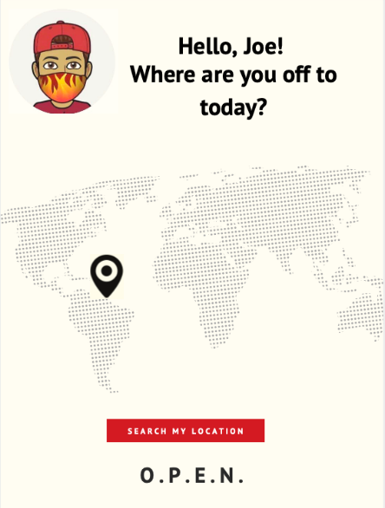
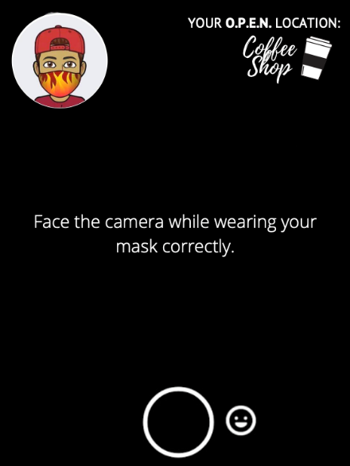
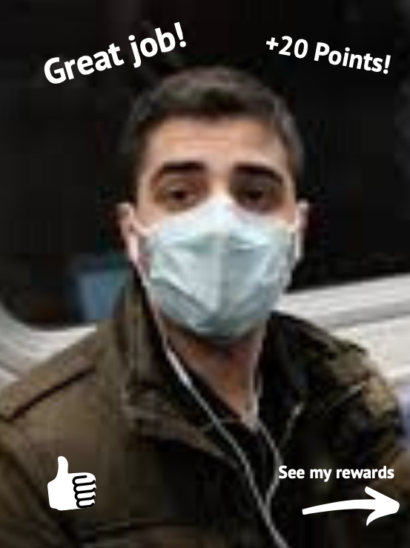
Team 28
O.p.e.n.
open prepared empowered neighbors
Notes:
I am going to share a story from a friend:
I am a mom, a wife to a scientist, and a nurse for life. I’ve been fighting Chrones di. for 13 years.
I stay home as much as possible, in the wake of COVID-19
With states reopening, I encourage you to continue to make decisions with the wellbeing of others in mind. What a world this could be if we all truly believed that ‘we are in this together.’
How many you can relate the emotion of this story?

Slide 2
As we reopen, how do we get the general public to practice correct hygiene practices?
Problem
Notes:
This story highlights our current problem How do we get and maintain people buy in to practice proper hygiene as our businesses reopen
Everyone wants to get back to business. Business want to reopen and want to maintain social distances.

Slide 3
O.P.E.N. a mobile app that encourages proper mask wearing and allows the user to earn reward points
Solution
Notes:
Enter OPEN:
Solution: O.P.E.N . Open Prepare Empowered Networks. Maintain proper infection control practices by encouraging behavioral change through an app. The app will have a reward feature that business could participate in. It also a platform where business could promote themselves. It can also be easily connected with social media to encourage a sense of community. Customers will feel like they are contributing to the efforts and get rewarded for positive behavior. They will also have an added sense of security and safety.
Social media filter checkin that acknowledges proper masking and geotags and earns rewards points at checkin to open businesses

Slide 4
Video demo removed due to file size limitations of GitHub
App Features
Notes:
So as the demo plays imagine yourself walking into your favorite coffee shop where you check in with our the app geotagging capabilities before you enter to confirm using facial recognition properly wearing your mask and once confirmed you could earn rewards with this business for your contribution to safe.
Now imagine you have visited the coffee shop 10x with O.P.E.N. App and you have confirmed you proper mask wearing each time which has now earned you a free coffee! In our phased approach we could partner with businesses such that they are excited to promote they are participating in O.P.E.N. as well to encourage the general public in their safe practices.
A Gamified app that includes a Geo-tagging component to check-in at businesses
And allows you to earn rewards based off of proper mask wearing. The app could easily integrate with various social media platforms to engage followers to take part in the fun of proper hygiene while supporting businesses.
So as the demo plays imagine yourself walking into your favorite coffee shop where you check in with our the apps geotagging capabilities before you enter to confirm using facial recognition properly wearing your mask and once confirmed you earn rewards
Gamification/reward system Facial recognition to ensure proper mask use Geo-tagging component to tag businesses Easily integrates with social media platforms
Facial Recognition for mask wearing leveraging Social Media
Geo-tagging to earn points with rewards programs with various companies at checkin with proper PPE
geo-mapping to encourage safe distancing practices that alerts user when they get too close (think pokemon Go)
Able to easily integrate with all social media platforms
Address the issue through awards and not punitive.
Could buy into an existing reward problem.
Would like to hear a call to action: What’s going to make a populations that are opposed to mask wearing?

Slide 5
Consumers Business representatives
Market Research
Notes:
In our market research, we conducted interviews with our target audiences: consumers and business representatives.
Business representatives = persons in leadership positions in their business

Slide 6




Business that Are Supporting US
Notes:
The following businesses have already expressed support of this app concept and rewards system.

Slide 7
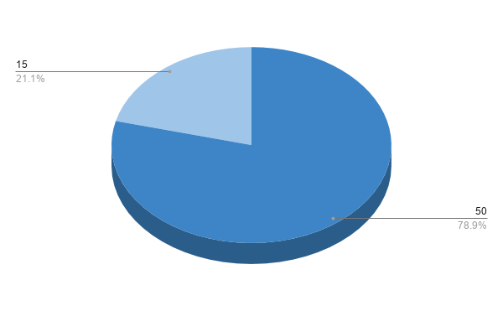
research results
Consumers who WOULD engage
Consumers who would NOT engage

Slide 8
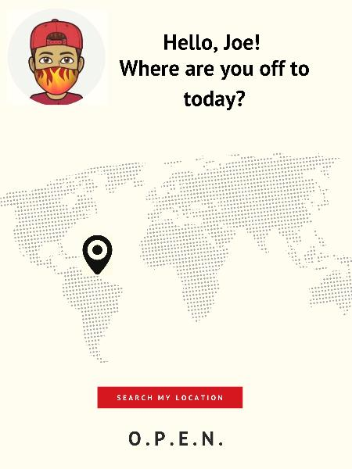

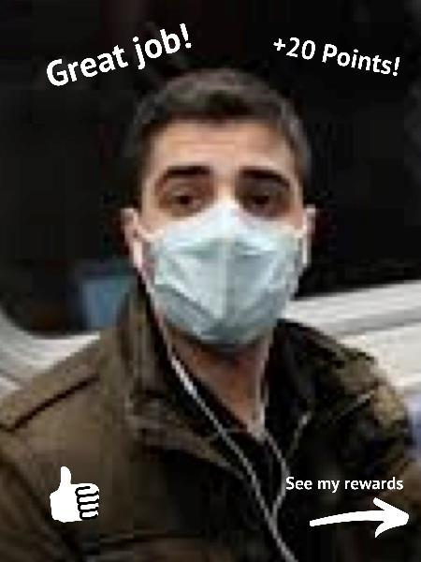
Team Members
Rebecca Steele
Kimberly LECORPS
Sarah portis
Special thanks to andrew penn and david winegar
Notes:
The potential for this app to garner a following could have a huge impact safely re-opening buisnesses and getting back to life.

